Slide 1
zekeLabs
Spark Architecture
Learning made Simpler ! www.zekeLabs.com

Slide 2
Agenda

Slide 3
Internal working of Spark
Similar to Hadoop, Spark also uses master slave architecture.
One master & many salves. Driver is central coordinator.
Driver & executor program runs in its own Java process.
These drivers handle a large number of executors.
Each executor works as a separate java process.
Spark application is a collaboration of driver and its executors.

Slide 4
More ...
Spark has its own cluster manager .i.e standalone cluster manager.
Spark can work with many open source cluster manager like yarn, mesos.

Slide 5
Terminology
Spark Application
Task
Job
Stages

Slide 6
Componets of Spark
Driver
Job scheduling & negotiation with cluster manager
Stores RDD information
Executor
Performs all data processing
Store computation results in memory
ClusterManager
Acquiring resources from spark cluster
YARN, Mesos

Slide 7
Run-Time Architecture of Spark Application
Driver talks to cluster manager & negotiates for resources.
Cluster manager launches executors on behalf of the driver.
Executors register themselves with driver.
When the job enters the driver converts the code into a logical directed acyclic graph (DAG).
Optimization of DAG.
Physical execution Plan with set of stages.
Small execution units known as tasks. Tasks are sent to cluster.

Slide 8
More ...
Executors executes all the tasks assigned by the driver.
The driver program monitors the executors that run.
In the spark architecture driver program schedules future tasks.
All the tasks by tracking the location of cached data based on data placement.
When it calls the stop method of sparkcontext, it terminates all executors.
After that, it releases the resources from the cluster manager

Slide 9
What is Cluster Manager ?
Cluster manager provides resources to all worker nodes as per need.
Three major types of cluster manager - standalone cluster manager, Hadoop YARN, Apache Mesos

Slide 10
Deploy Mode in Spark - Client & Cluster
There are two possible ways - Cluster mode & client mode.
Spark Client Mode
Driver component is running on the machine where job is submitted.
Job submitting machine is expected to be near the spark infra, otherwise latency in data movement.
Spark Cluster Mode
Driver is not in the local machine where job is submitted.
Job submitting machine is expected to be near the spark infra, otherwise latency in data movement.

Slide 11
Standalone Cluster Manager
Available with Spark
It has HA for the master, is resilient to worker failures, has capabilities for managing resources per application,
Can run alongside of an existing Hadoop deployment and access HDFS

Slide 12
Spark on Standalone
Start master - ./sbin/start-master.sh. This returns host & port number on which it is running.
Start slave - ./sbin/start-slave.sh master-spark-URL. Keep running these in slaves which you want to connect to server.
./bin/spark-shell --master spark://IP:PORT

Slide 13
YARN
Yet another resource negotiater.
YARN is distributed OS for Hadoop.
It's main responsibility is job scheduling as well as resource management.

Slide 14

Cluster Mode Overview

Slide 15
Important Points
Each application gets its own executor processes. Thus, applications are isolated from each other & data sharing between applications is also not possible.
Spark is agnostic if cluster manager, as long as processes can communicate.
Driver & executors should be network reachable.

Slide 16
Launching Spark on YARN
In YARN, each application has ApplicationMaster process.
That is generally the first container started for that application.
The application is responsible for requesting resources from the ResourceManager.
As soon as resources are allocated, the application instructs NodeManagers to start containers on its behalf.

Slide 17
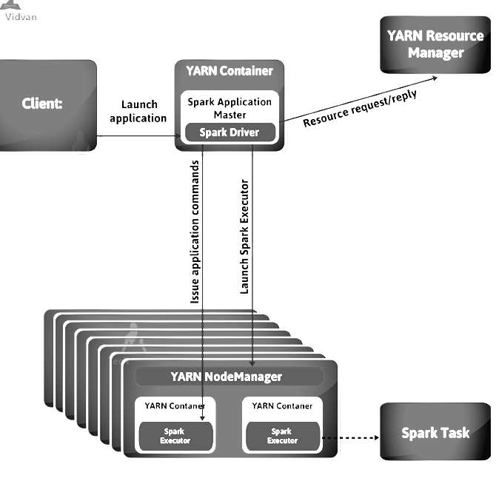
Cluster Deployment Mode on YARN
Driver runs in ApplicationMaster
Client that launches the application need not continue running for the complete lifespan of the application.
For using spark interactively, cluster mode is not appropriate.

Slide 18
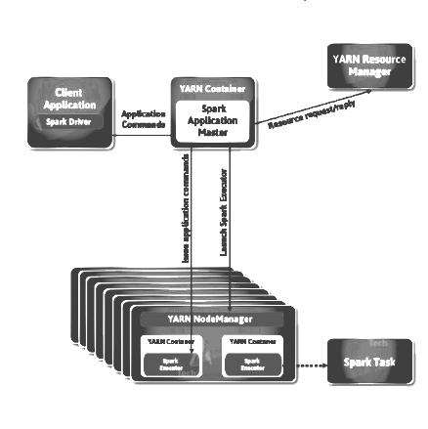
Client Deployment Mode on YARN
When the driver runs on the host where the job is submitted, that spark mode is a client mode.
To request executor containers from YARN, the ApplicationMaster is merely present here.

Slide 19
Thank You !!!

Slide 20
THANK YOU
Let us know how can we help your organization to Upskill the employees to stay updated in the ever-evolving IT Industry.
Get in touch:
www.zekeLabs.com | +91-8095465880 | info@zekeLabs.com
Visit : www.zekeLabs.com for more details

